Slide 1

Data Description
Session 6
Mercedeh ERFANIANGHASAB & Jérémy CELSE
Mercedeh.ERFANIANGHASAB@essca.fr | jeremy.celse@essca.fr

Slide 2
Exercise 1
Temperature | Frequency
-1 | 20%
0 | 17%
2 | 43%
3 | 10%
7 | 10%
We studied the morning temperature (i.e. measured between 7am and 7.30am) over 200 days chosen randomly from the winter periods observed over the last 20 years.
The data are represented in the following table:
Calculate the mode(s) associated with the data
Calculate the average morning temperature

Slide 3


Exercise 1 - Solution
Temperature | Number of days | $$f_{i}$$
-1 | 40 | 20%
0 | 34 | 17%
2 | 86 | 43%
3 | 20 | 10%
7 | 20 | 10%
Total | 200 | 100%
$Mode=2$
$\overline{x}= \frac{−1×40+0×34+2 ×86+3 ×20+7×20}{200}=−1 ×0.2+0×0.17+2×0.43+3×0.1+7×0.1$ $=1.66$

Slide 4
Exercise 2
Speed | Number of days
[0 ; 10] | 42
[10 ; 30] | 48
[30 ; 70] | 90
[70 ; 100] | 24
[100 ; 150] | 36
We studied the morning speed (i.e. measured (in Km/h) between 7am and 7.30am) of the wind over 240 days chosen randomly from the winter periods observed over the last 20 years.
The data are represented in the following table:
Calculate the mode(s) associated with the data
Calculate the mean morning wind speed

Slide 5
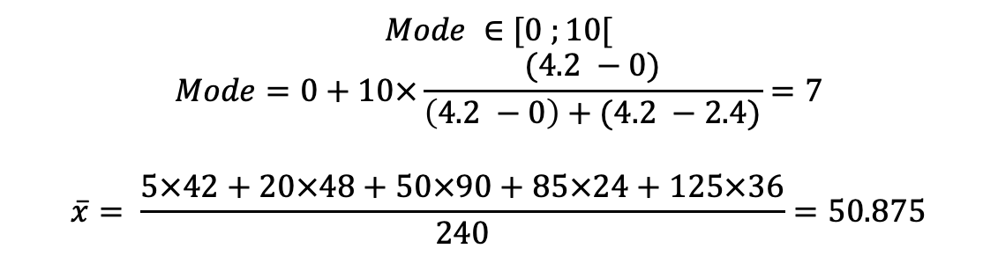
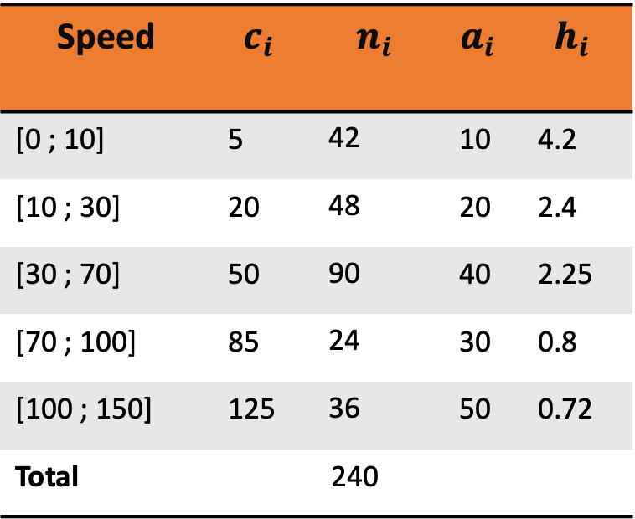
Exercise 2 Solution
Speed | $$c_{i}$$ | $$n_{i}$$ | $$a_{i}$$ | $$h_{i}$$
[0 ; 10] | 5 | 42 | 10 | 4.2
[10 ; 30] | 20 | 48 | 20 | 2.4
[30 ; 70] | 50 | 90 | 40 | 2.25
[70 ; 100] | 85 | 24 | 30 | 0.8
[100 ; 150] | 125 | 36 | 50 | 0.72
Total |  | 240
$$Mode ∈[0 ;10[$$
$$Mode=0+10×\frac{(4.2 −0)}{\left(4.2 −0\right)+(4.2 −2.4)}=7$$
$$\overline{x}= \frac{5×42+20×48+50×90+85×24+125×36}{240}=50.875$$

